Slide 1
JUKEVOTE
Cantón Fernández, Adrián
Carpio Camacho, Daniel
Fresno Aranda, Rafael
Rebollo Lobo, Pablo
Juan

Slide 2
Business idea
Allow people to vote what music will be played in a pub or a disco.
Display in a map the places where this app is being used anda additional information about the venue.
Allow to organize raffles to encourage the participation of people inside the venue

Slide 3
businESS IDEA
The principal source of income will be selling the license to use this app to venues owners.
Premium accounts with extra features may be implemented
The main goal to develop a web application, but later on a mobile application Will make the voting process more appealing

Slide 4
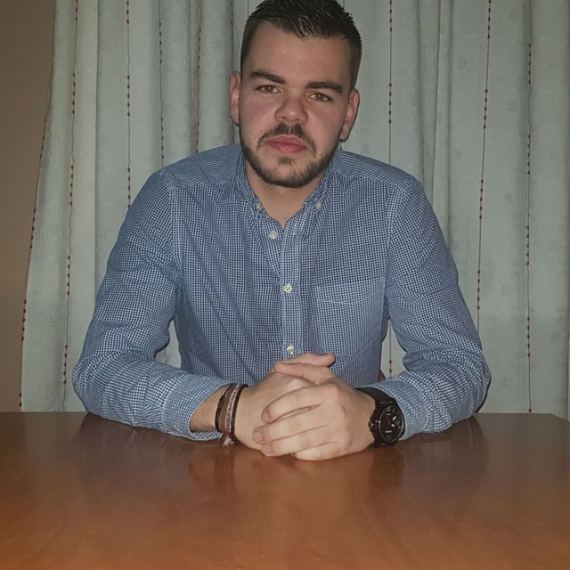
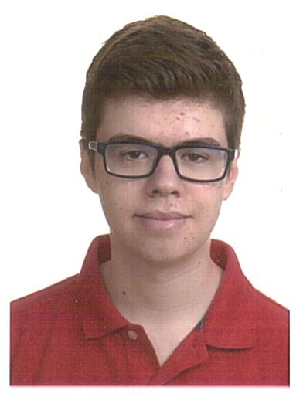
Our team
Adrián Cantón: Business management/Mobile application developer
Daniel Carpio: Analist/Frontend developer
Juan Apellido: Requirements engineer/Backend developer
Rafael Fresno: Backend developer/API integration
Pablo Rebollo: Backend developer/Project manager

Slide 5
Core requirements
3 types of users: Owners, attendants and system administrators.
Our system will store data related to the venues where it is being used and their owners.
Owners will be able to customize the list of songs that Will be played.
Owners will be able to register events in the application
Attendants will receive a code they can use in order to vote which song they want to listen.
Attendants will be able to see information related to venues that use this application, such as their events and their geographical location.
Administrators can suspend a owner or attendant account when necessary

Slide 6
Mvp placeholder

Slide 7
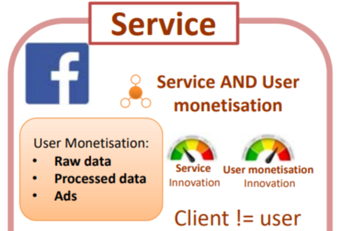
Mvp classification
Our software provide as service where our clients are not the users.
This software’s license will be sold to businesses that will tailor it to their own clients’ needs, who will be the main users of our app functionalities.

Slide 8
OUR COMPETITORS
play.festa.co

Slide 9
INNOVATION PLACEHOLDER

Slide 10
COSTS PLACEHOLDER

